Slide 1
Salary and compensation analysis through Excel
Data Modeling
STUDENT NAME: K.MEENAKSHI
REGISTER NO:312217473
DEPARTMENT:III B.COM (GENERAL)
COLLEGE: PONNUSAMY NADAR COLLEGE OF ARTS AND SCIENCE

Slide 2
PROJECT TITLE
SALARY AND COMPENSATION ANALYSIS
THROUGH EXCEL DATA
MODELING

Slide 3
AGENDA :
Problem statement
Project overview
End users
Our solution and proposition
Data set description
The wow in our solution
Modeling approach
Result and description
Conclusion

Slide 4
PROBLEM Statement
To analyze the salary and compensation data of employees in order to identify patterns,
disparities, and areas for improvement. This
analysis will help in making data-driven
decisions regarding salary adjustments, budget
allocations, and employee satisfaction.
Key questions
Gender pay gap
Market competitiveness

Slide 5
Project overview:
In this project, we used Excel data modeling to analyze employee salary and compensation. By organizing and examining data on salaries, bonuses, and benefits, we identified trends and discrepancies. Utilizing pivot tables and statistical tools, we provided insights into compensation structures, ensuring fairness and competitiveness within the organization. The analysis supports informed decisions on employee pay and resource allocation.
We analyzed employee salaries and compensation using Excel. Data on base pay, bonuses, and benefits was organized. We identified trends and discrepancies. Pivot tables and statistical tools provided insights. The analysis ensures fair and competitive compensation. It supports informed decisions on employee pay.
Project initiative
Data Structuring in Excel
Descriptive analysis
Comparative analysis
Creative dashboards

Slide 6
WHO ARE THE END USERS :
Human Resources (HR) Professionals Finance Departments Department Managers and Team Leads Executive Leadership Employees Consultants

Slide 7
OUR SOLUTION AND ITS VALUE PROPOSITION:
Excel provides robust tools for salary and compensation analysis. It enables detailed data analysis using functions, pivot tables, and charts to gain insights into salary distributions and trends. Customizable models allow organizations to tailor dashboards and track various compensation metrics like base salaries and bonuses. Scenario forecasting tools, such as data tables and solver, help assess the impact of different compensation scenarios. Excel also supports effective cost management by calculating total compensation expenses and identifying necessary budget adjustments. Additionally, its reporting and visualization features help communicate findings clearly to stakeholders.

Slide 8
DATA SET DESCRIPTION:
To analyze salary and compensation using Excel: 1. Organize Data: Clean and structure data with columns for salaries, bonuses, job titles, etc. 2. Descriptive Stats: Use functions like AVERAGE, MEDIAN, and STDEV. 3. Pivot Tables: Summarize data by department or job title. 4. Visualizations: Create charts to visualize distributions and trends. 5. Advanced Analysis: Perform regression and correlation analysis to explore relationships. 6. Reporting: Build dashboards and document key findings.

Slide 9
THE “WOW” IN OUR SOLUTION:
1. Collect Data: Gather salary, bonus, and benefit information.
2. Organize Data: Arrange data in Excel with relevant columns.
3. Analyze: Use formulas (e.g., AVERAGE) and pivot tables to understand compensation trends.
4. Model: Perform scenario analysis and what-if scenarios.
5. Report: Create charts and dashboards to present insights.

Slide 10
MODELING APPROACH:
To analyze salary and compensation using Excel, start by gathering and cleaning data on salaries, job titles, and other relevant factors. Organize the data in a table and perform exploratory analysis with pivot tables and charts. Use statistical functions to calculate averages and standard deviations. Apply regression analysis to understand how factors impact salary and use visualizations to present trends. Conduct scenario analysis to explore the effects of variable changes and summarize your findings in a clear report, validating results with external benchmarks.
To analyze salary and compensation using Excel:1. **Organize Data**: Clean and structure data with columns for salaries, bonuses, job titles, etc.2. **Descriptive Stats**: Use functions like AVERAGE, MEDIAN, and STDEV.3. **Pivot Tables**: Summarize data by department or job title.4. **Visualizations**: Create charts to visualize distributions and trends.5. **Advanced Analysis**: Perform regression and correlation analysis to explore relationships.6. **Reporting**: Build dashboards and document key findings.

Slide 11
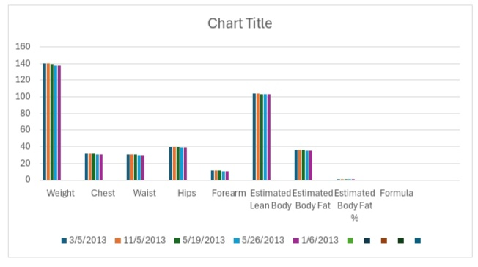
RESULTS :

Slide 12
CONCLUSION:
In conclusion, the Excel-based salary analysis revealed key insights: a skewed salary distribution suggests issues with progression, a gender pay gap is evident in senior roles, and some positions are undercompensated compared to industry standards. Additionally, while bonuses are fairly distributed, inconsistencies in non-monetary benefits may impact employee satisfaction. Addressing these areas can enhance fairness, competitiveness, and retention.

